Slide 1


DAMG6210
MOVIEMATE
A MOVIE TICKET BOOKING SYSTEM
TEAM 16
KAUSHIK
MUSKAN
NIKHIL
KUSUMANTH
SHAUN

Slide 2


OVERVIEW
MovieMate is a movie reservation system database project created using SQL Server and integrated with the Streamlit Python library for a user-friendly graphical interface.
This project aims to provide a comprehensive solution for managing movie reservations efficiently.
MovieMate is equipped with robust features including triggers, stored procedures, encryption mechanisms, and user-defined functions, ensuring data integrity, security, and seamless functionality. With its intuitive interface powered by Streamlit, users can effortlessly navigate through the system, making movie reservations and managing bookings with ease, all while enjoying a seamless and efficient experience.

Slide 3
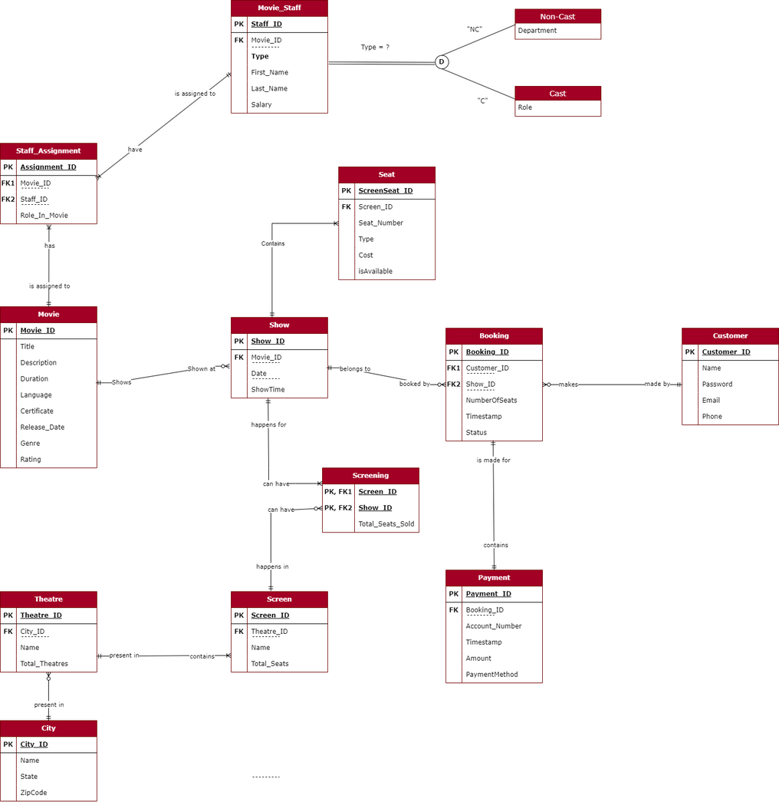

ENTITY RELATIONSHIP DIAGRAM

Slide 4
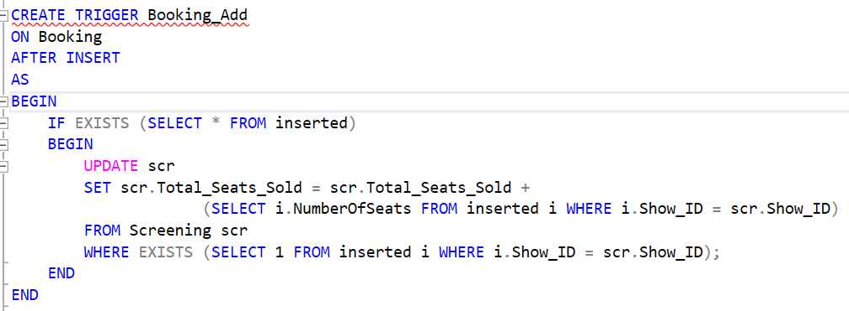

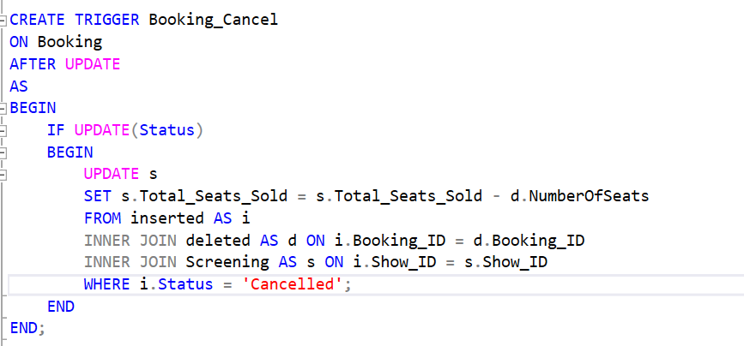
OUR BEST WORK - TRIGGERS!

Slide 5
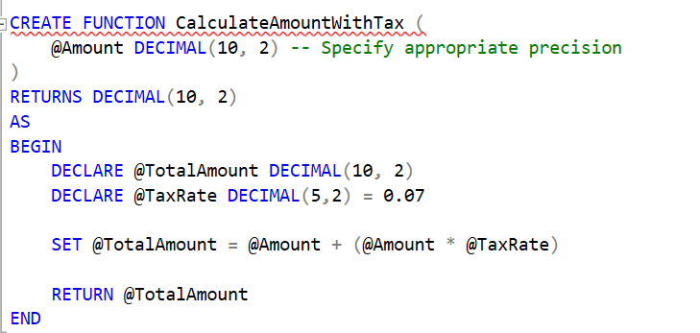

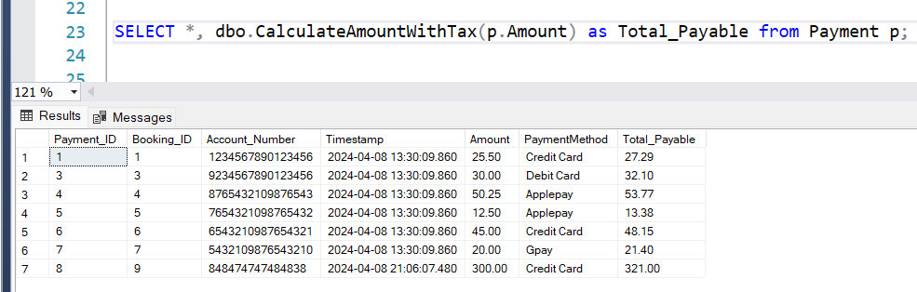

THS IS WHY TICKETS ARE EXPENSIVE?
Tax is User Defined,
That’s why it's annoying

Slide 6
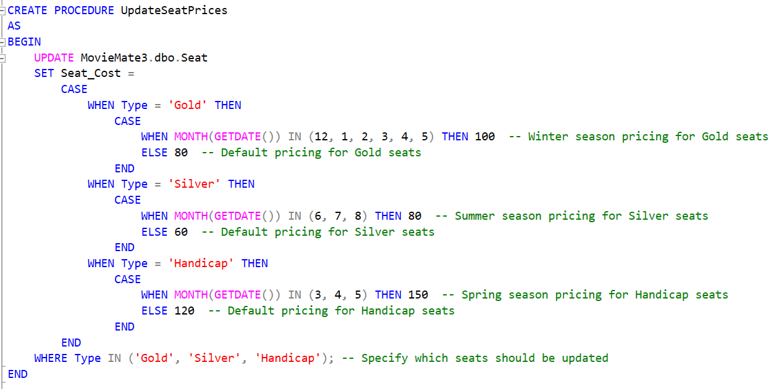

LOWERED PRICES TRICK
How often are you tempted to go for a movie just based on lowered prices?
There is a procedure to set the prices for us. It’s a cool trick, but it works!
Sofishticated Bait

Slide 7
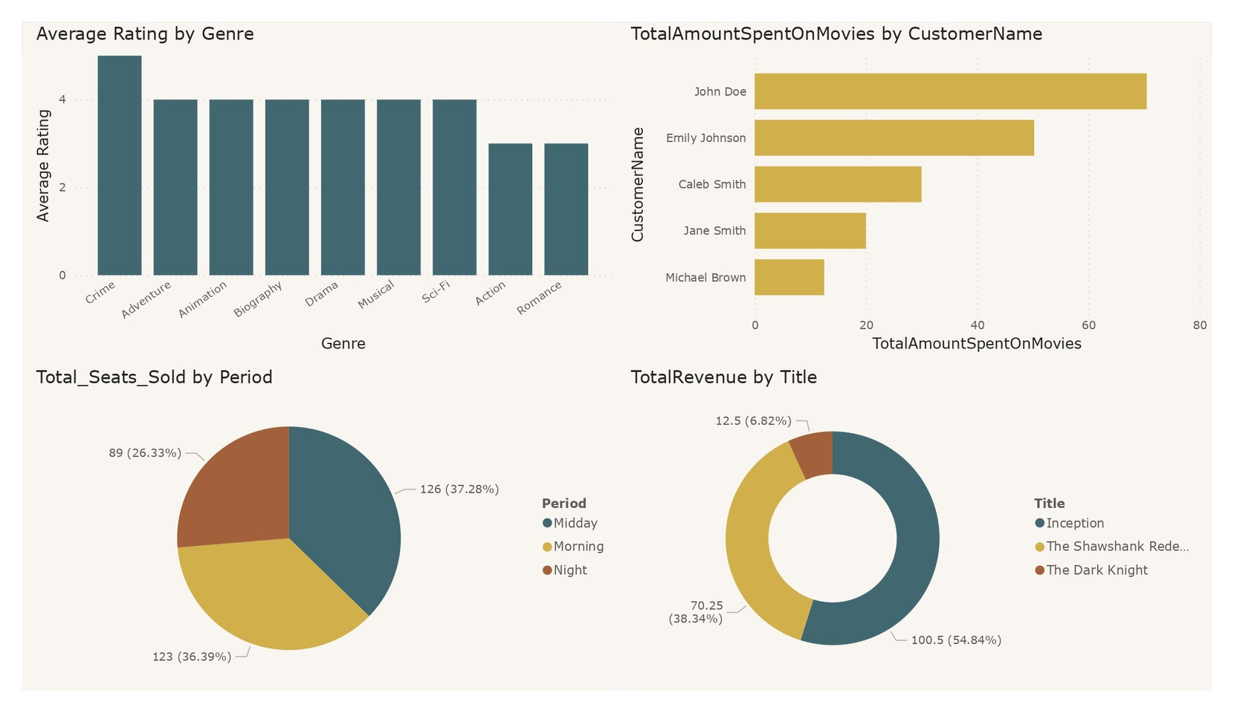

I CALL THE SHOTS!
Here’s the secret to
my strength

Slide 8







ENJOY THE DEMO
Do not disturb others during the show
All devices must be turned off or kept in Silent
It’s not much, but it’s hard work

Slide 9















THANK YOU

